Slide 1

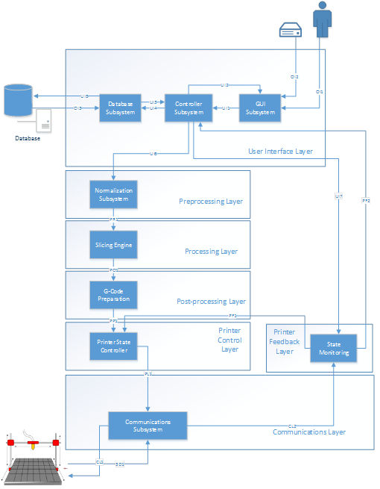
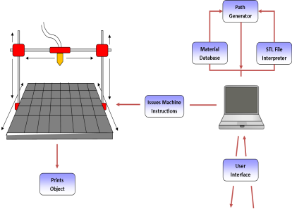
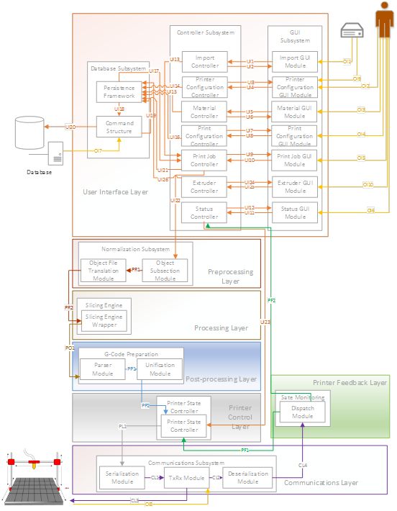
Team Ink3D 3DPrinter Fabrication System
Group Photo
Critical Requirements
3.1 STL File Input | Completed
3.4 Issue Machine Instructions | Partially Completed
3.5 Monitor Temperature | Completed
3.6 Monitor Position | Completed
3.8 Identify Materials | Completed
3.9 Identify Shapes | Completed
3.10 Determine Shape of Support Material Structure | Completed
3.11 Create Printing Path | Completed
3.14 Slice Geometry into Thickness Levels | Completed
3.17 Allow for UV Head Polymerization | Completed
Role | Assigned To | Responsibility
Project Manager | Daniel Lain | Maintain Project Plan Assign Tasks to Team Turn in Deliverables Risk Manager Change Approval
Hardware Lead | Shawn Simonson | Plan Hardware Interfaces Research Hardware Hardware Development ME Liaison Change Approval
Software Engineering Lead | Jesse Bowles | System Architecture Modular Planning Scalability Planning Develop UMLs Change Approval
Lead Programmer | Tim Edmonson | Algorithm Development Open Source Selection Algorithm Research Change Approval
System Test Plan
Lessons Learned
Understand the customer’s needs
Constant communication with team and customer
Ask for help when needed
Hold each other accountable
Design in as much detail as possible before implementation
Use resources available

Slide 2
Critical Requirements
3.1 STL File Input | Completed
3.4 Issue Machine Instructions | Partially Completed
3.5 Monitor Temperature | Completed
3.6 Monitor Position | Completed
3.8 Identify Materials | Completed
3.9 Identify Shapes | Completed
3.10 Determine Shape of Support Material Structure | Completed
3.11 Create Printing Path | Completed
3.14 Geometry Slicing | Completed
3.17 Allow for UV Head Polymerization | Completed

Slide 3
Lessons Learned
Understand the customer’s needs
Constant communication with team and customer
Ask for help when needed
Hold each other accountable
Design in as much detail as possible before implementation
Use resources available

